Slide 1
Intelligent Photo Editing

Slide 2




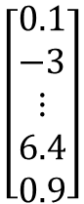
Modifying Input Code
$$\left[\begin{aligned}0.1 \\ −3 \\ ⋮ \\ 2.4 \\ 0.9\end{aligned}\right]$$
$$\left[\begin{aligned}3 \\ −3 \\ ⋮ \\ 2.4 \\ 0.9\end{aligned}\right]$$
Generator
Generator
Each dimension of input vector represents some characteristics.
Longer hair
$$\left[\begin{aligned}0.1 \\ −3 \\ ⋮ \\ 6.4 \\ 0.9\end{aligned}\right]$$
$$\left[\begin{aligned}0.1 \\ −3 \\ ⋮ \\ 2.4 \\ 3.5\end{aligned}\right]$$
Generator
Generator
blue hair
Open mouth
The input code determines the generator output.
Understand the meaning of each dimension to control the output.

Slide 3
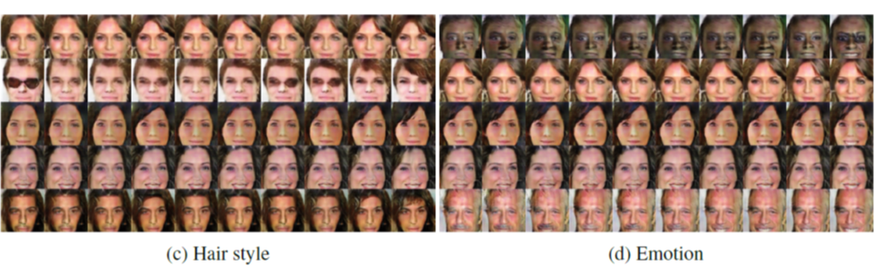
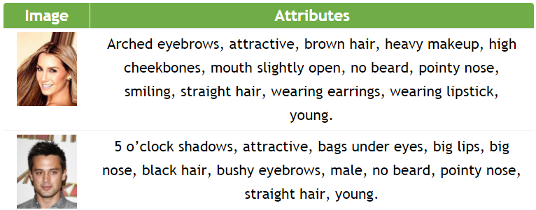
Connecting Code and Attribute
CelebA

Slide 4
GAN+Autoencoder
We have a generator (input z, output x)
However, given x, how can we find z?
Learn an encoder (input x, output z)
as close as possible
Encoder
Generator
(Decoder)
x
z
x
different structures?
init
fixed
Discriminator
Autoencoder
Notes:
En and dis have difference structure?

Slide 5
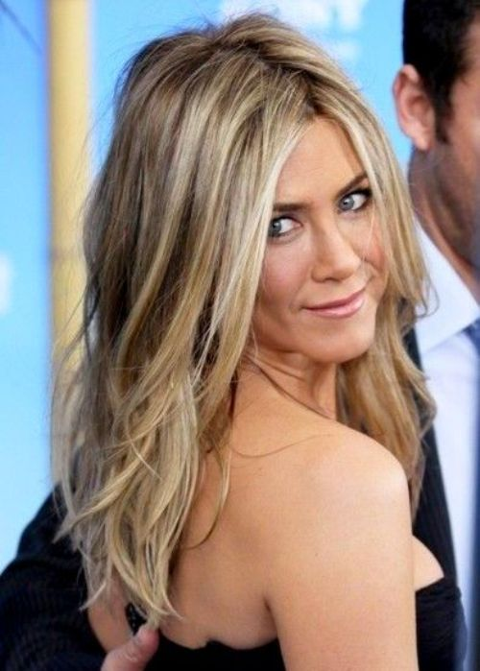
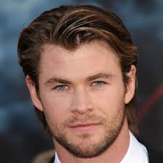
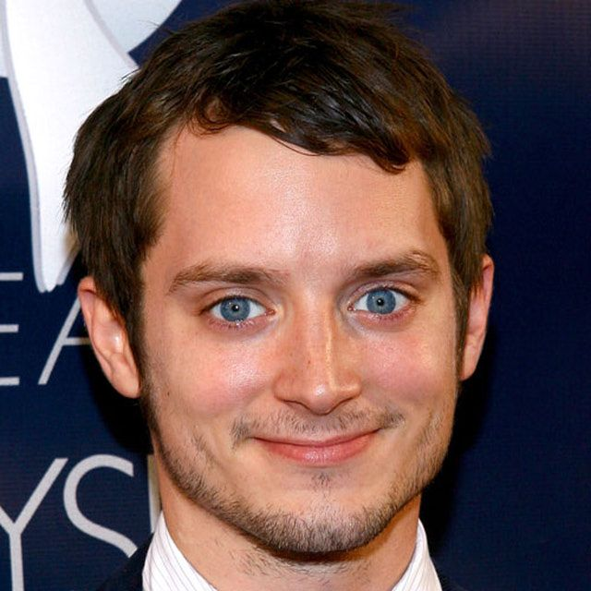
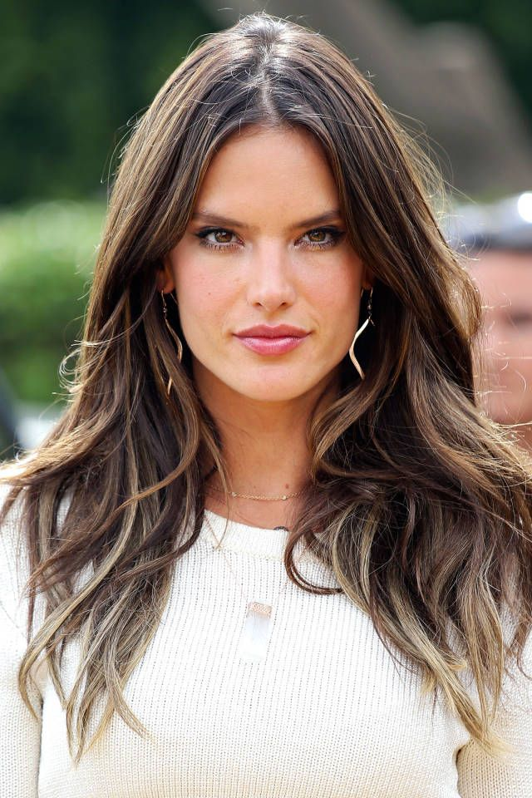
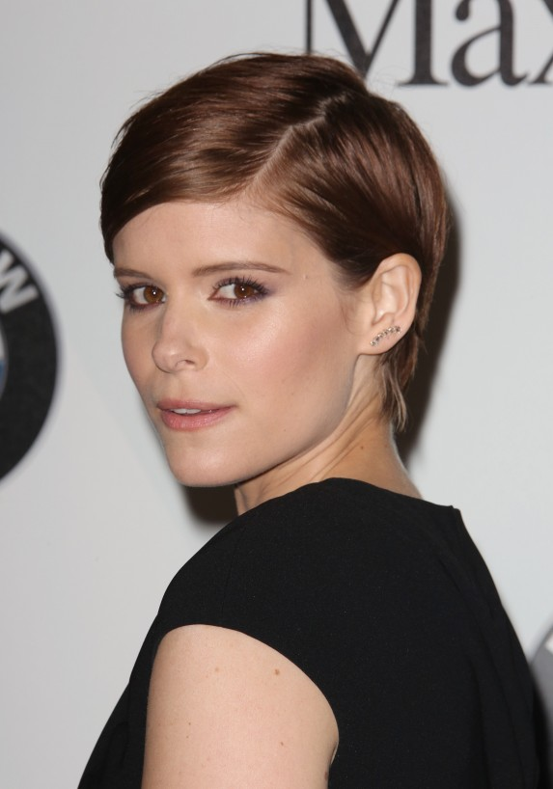
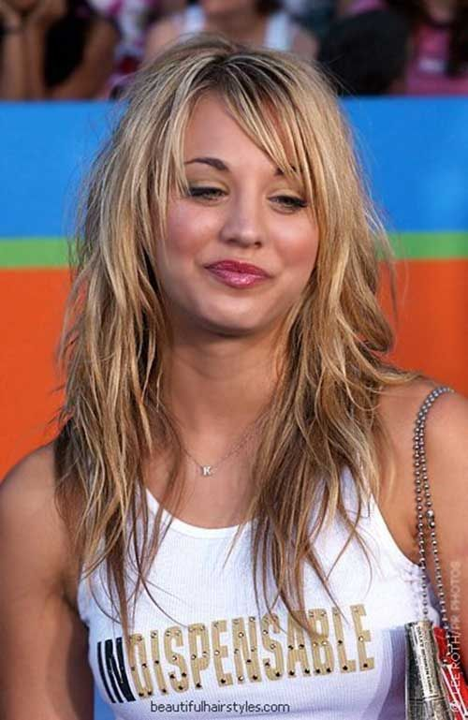
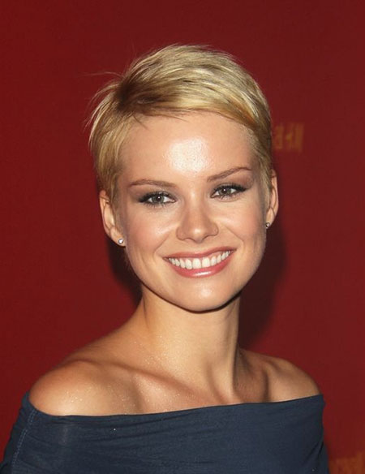
Attribute Representation
$$z_{long}$$
$$\frac{1}{N_{1}}\sum_{x∈long}{En\left(x\right)}$$
$$−\frac{1}{N_{2}}\sum_{x^{′}∉long}{En\left(x^{′}\right)}$$
$$z_{long}$$
$$=$$
Short
Hair
Long Hair
$$x$$
$$En\left(x\right)+z_{long}=z^{′}$$
$$Gen\left(z^{′}\right)$$
Notes:
Need a figure

Slide 6
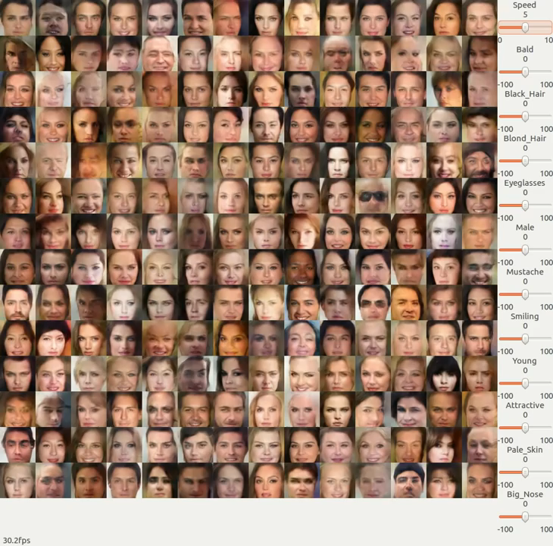
Photo
Editing
https://www.youtube.com/watch?v=kPEIJJsQr7U

Slide 7
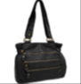


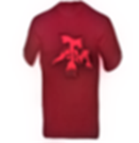
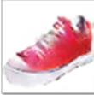
Basic Idea
Fulfill the constraint
space of
code z
Why move on the code space?

Slide 8
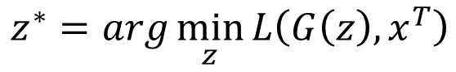


Back to z
$$z^{∗}$$
$$x^{T}$$
Method 1
Method 2
Method 3
$$z^{∗}=arg\min_{z}{L\left(G\left(z\right),x^{T}\right)}$$
Difference between G(z) and x^{T}
Pixel-wise
Gradient Descent
By another network
as close as possible
Encoder
Generator
(Decoder)
x
z
x
Using the results from method 2 as the initialization of method 1

Slide 9


Editing Photos
z₀ is the code of the input image
Using discriminator to check the image is realistic or not
image
$$z^{∗}=arg\min_{z}{U\left(G\left(z\right)\right)+λ_{1}{\left\|z−z_{0}\right\|}^{2}−λ_{2}D\left(G\left(z\right)\right)}$$
Not too far away from the original image
Does it fulfill the constraint of editing?

Slide 10
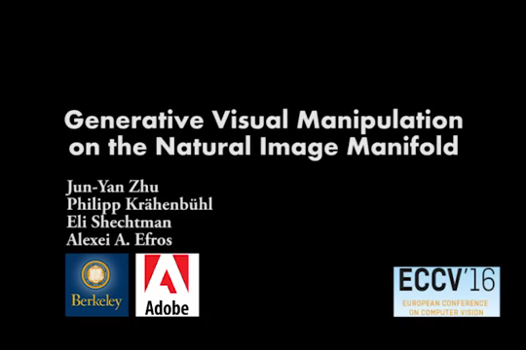
https://www.youtube.com/watch?v=9c4z6YsBGQ0
Jun-Yan Zhu, Philipp Krähenbühl, Eli Shechtman and Alexei A. Efros. "Generative Visual Manipulation on the Natural Image Manifold", ECCV, 2016.

Slide 11
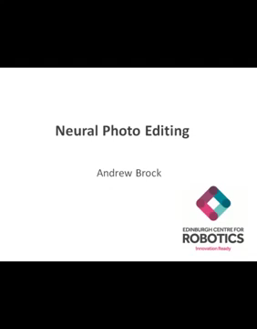
Andrew Brock, Theodore Lim, J.M. Ritchie, Nick Weston, Neural Photo Editing with Introspective Adversarial Networks, arXiv preprint, 2017

Slide 12
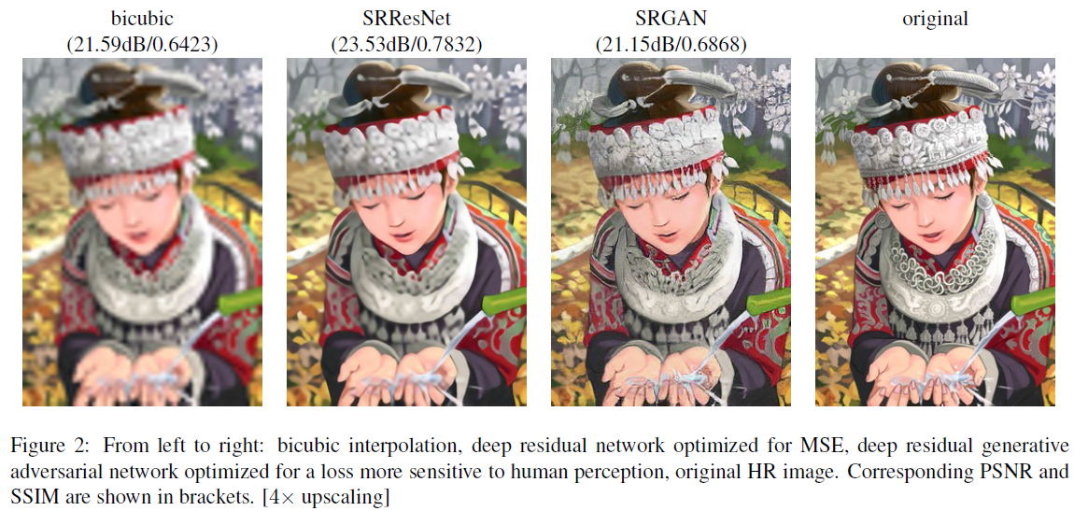
Image super resolution
Christian Ledig, Lucas Theis, Ferenc Huszar, Jose Caballero, Andrew Cunningham, Alejandro Acosta, Andrew Aitken, Alykhan Tejani, Johannes Totz, Zehan Wang, Wenzhe Shi, “Photo-Realistic Single Image Super-Resolution Using a Generative Adversarial Network”, CVPR, 2016

Slide 13
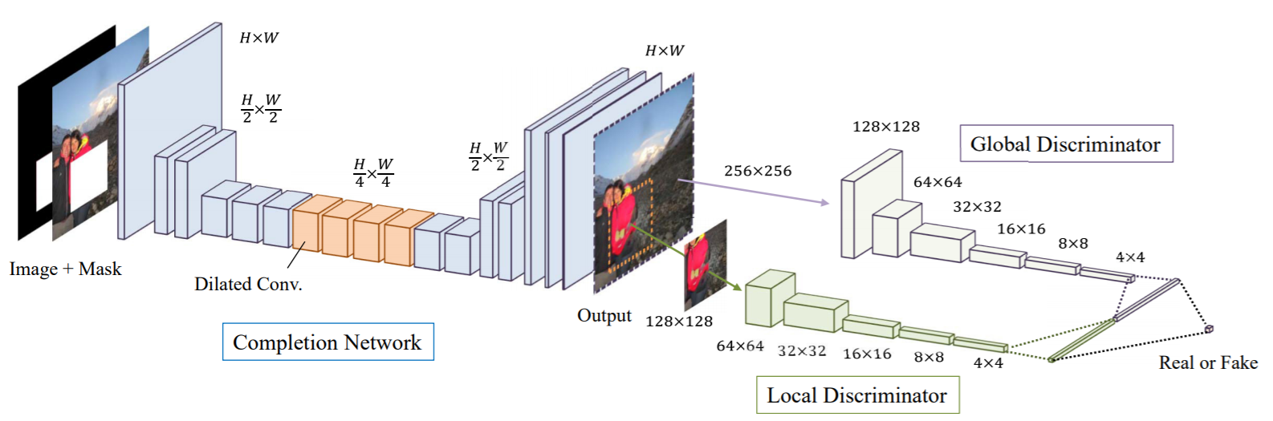
Image Completion
http://hi.cs.waseda.ac.jp/~iizuka/projects/completion/en/

Slide 14
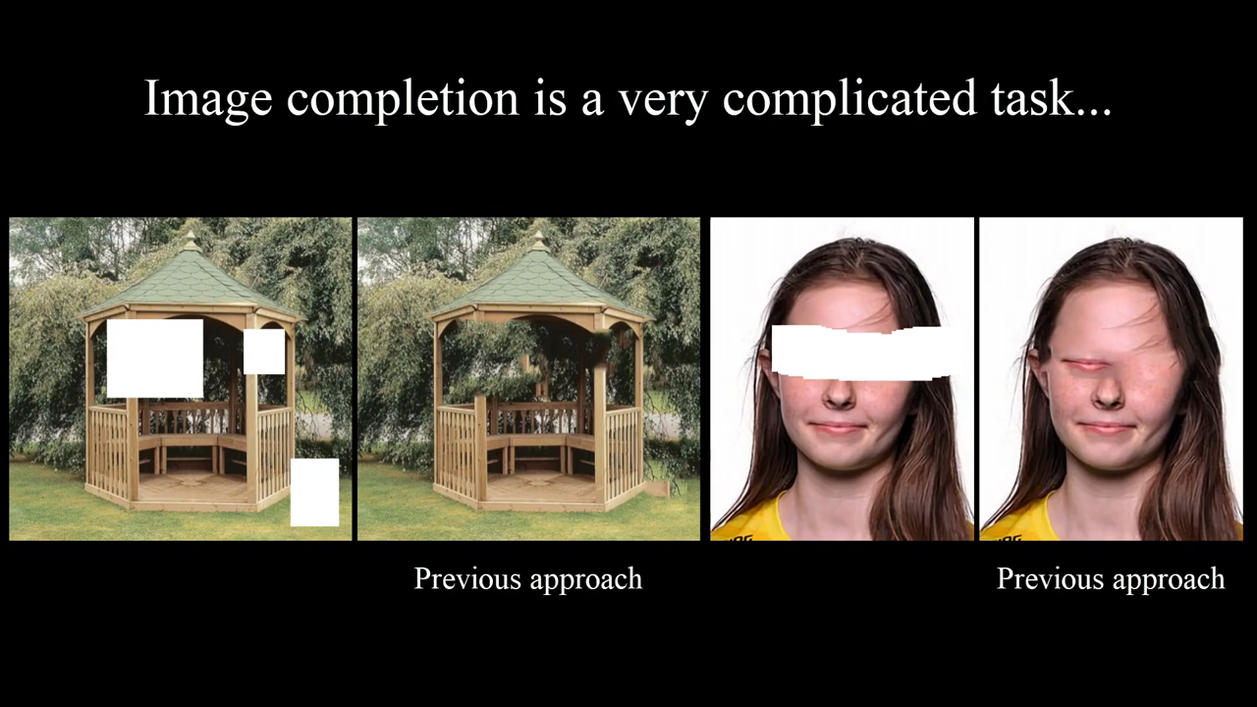
Demo
https://www.youtube.com/watch?v=5Ua4NUKowPU

